Slide 1
Group Meeting
Yunlong Pan

Slide 2
Outline
ADCIRC
Method 2: SMS
Output visualization
Demo
GitHub
Literature review
Reading from Ruyi
Flood Forecasting
WeatherBench2

Slide 3
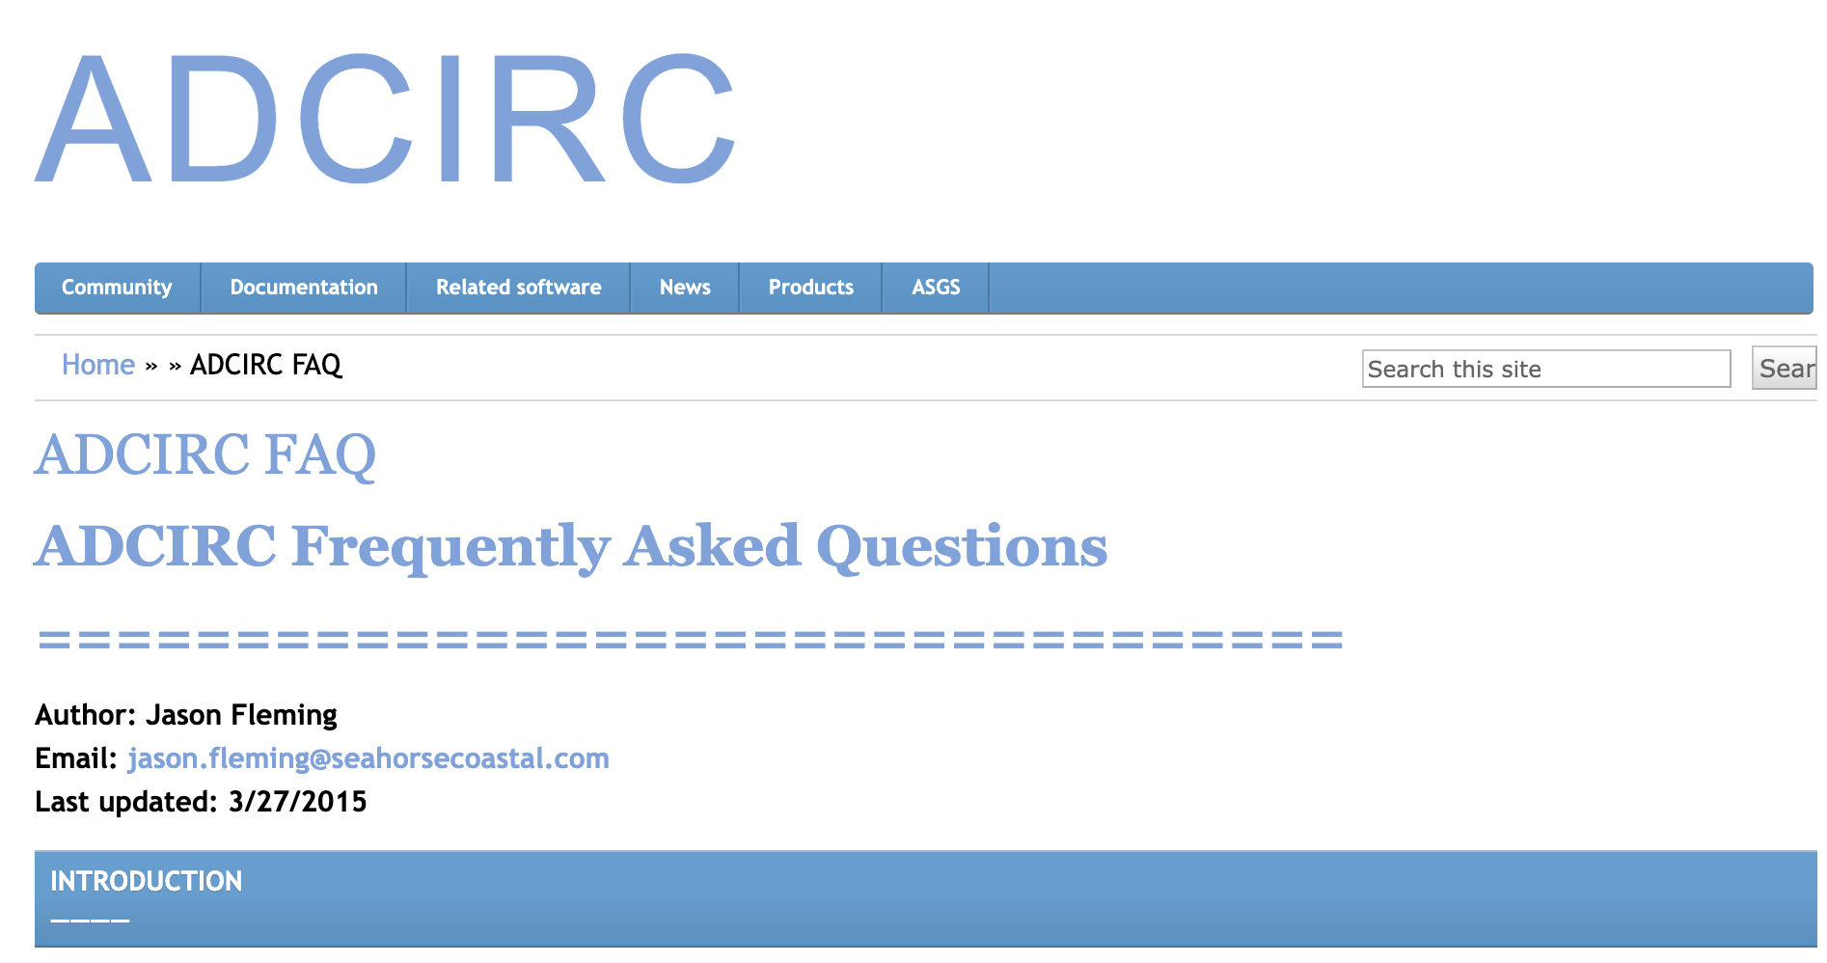
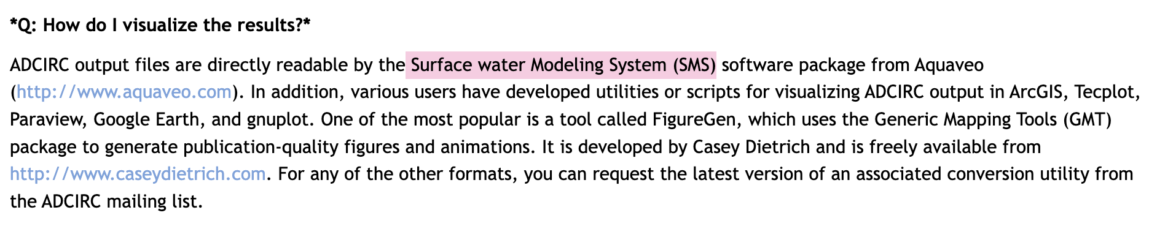
Method 2: SMS
https://adcirc.org/home/adcirc-faq/
https://www.aquaveo.com/

Slide 4
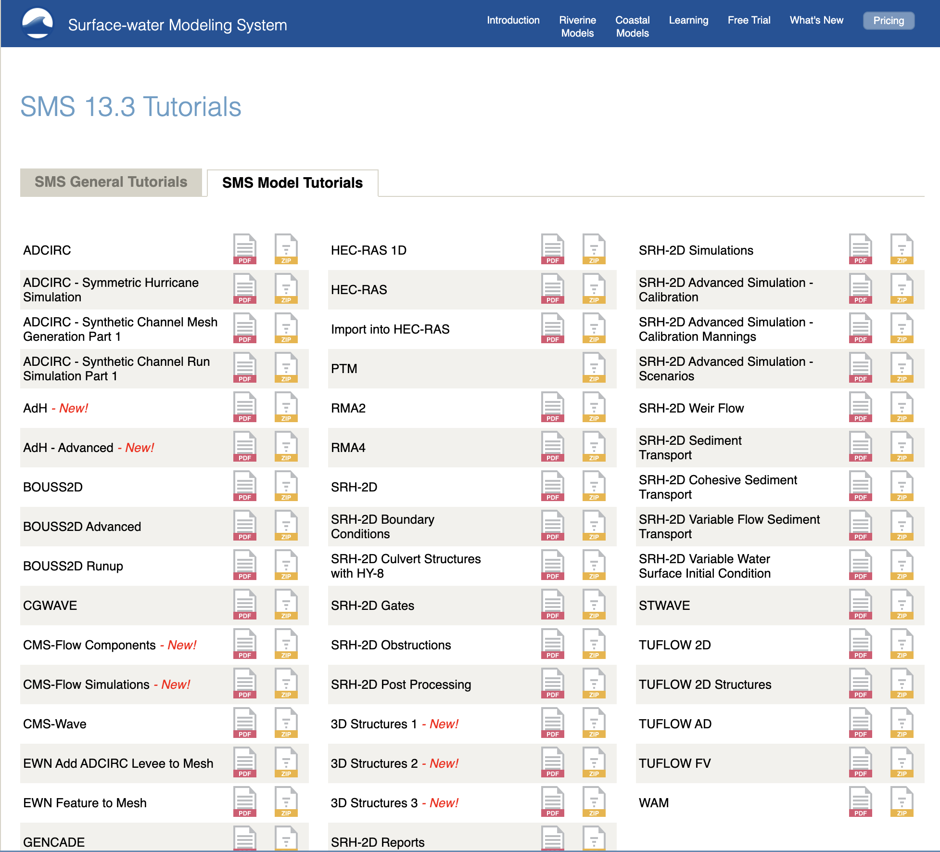
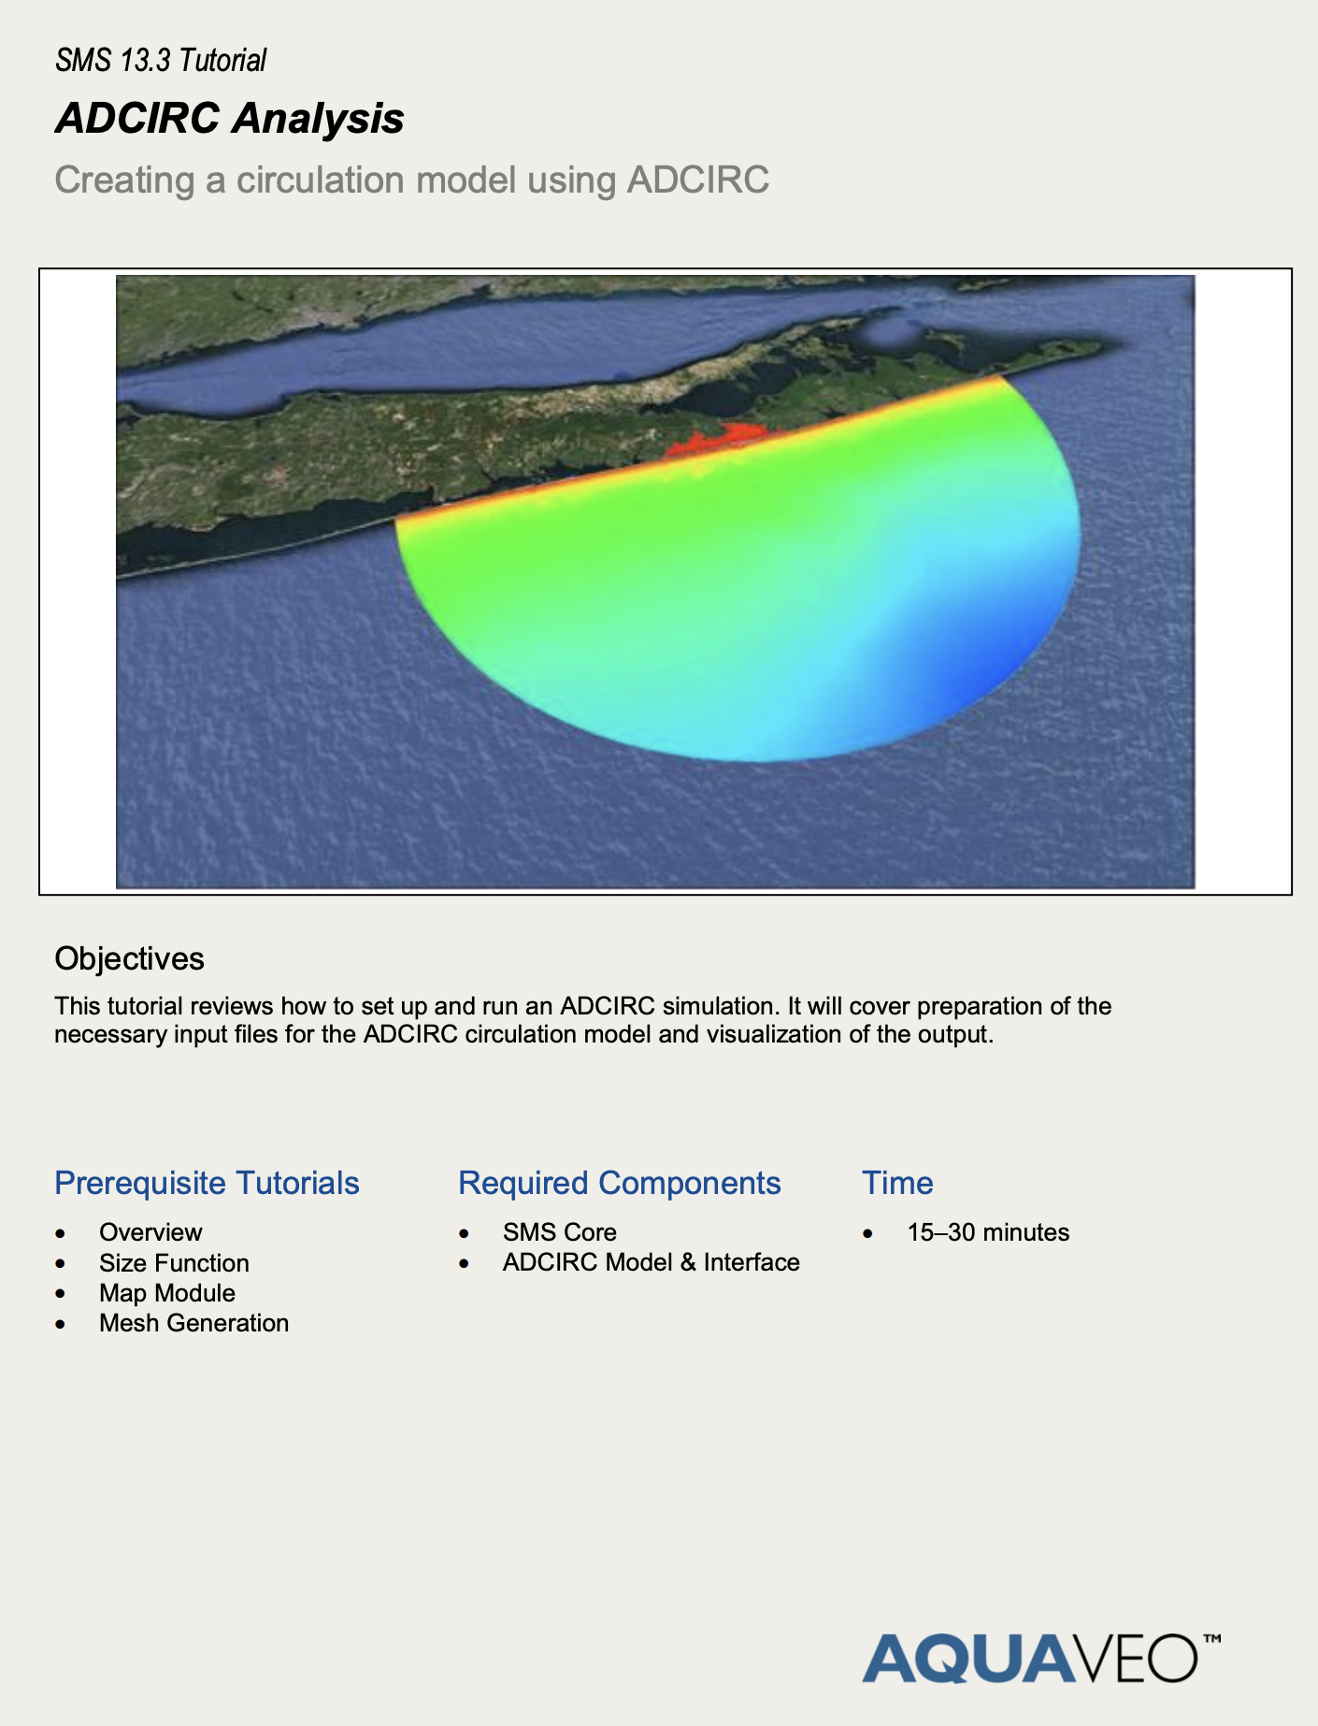
Method 2: SMS
https://www.aquaveo.com/software/sms-learning-tutorials

Slide 5
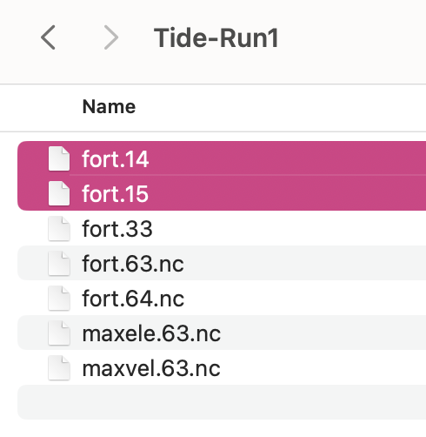
Method 2: SMS
https://www.aquaveo.com/software/sms-learning-tutorials

Slide 6
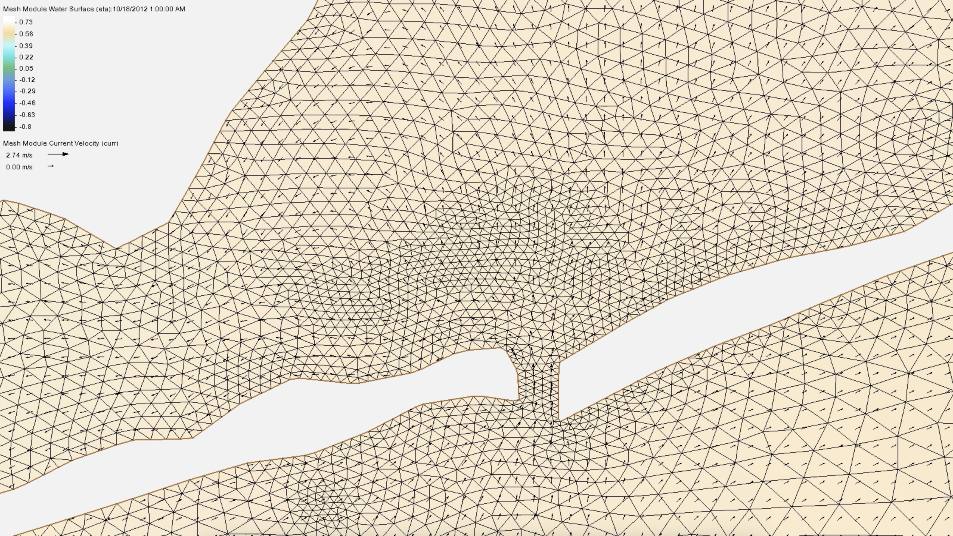
Output visualization

Slide 7
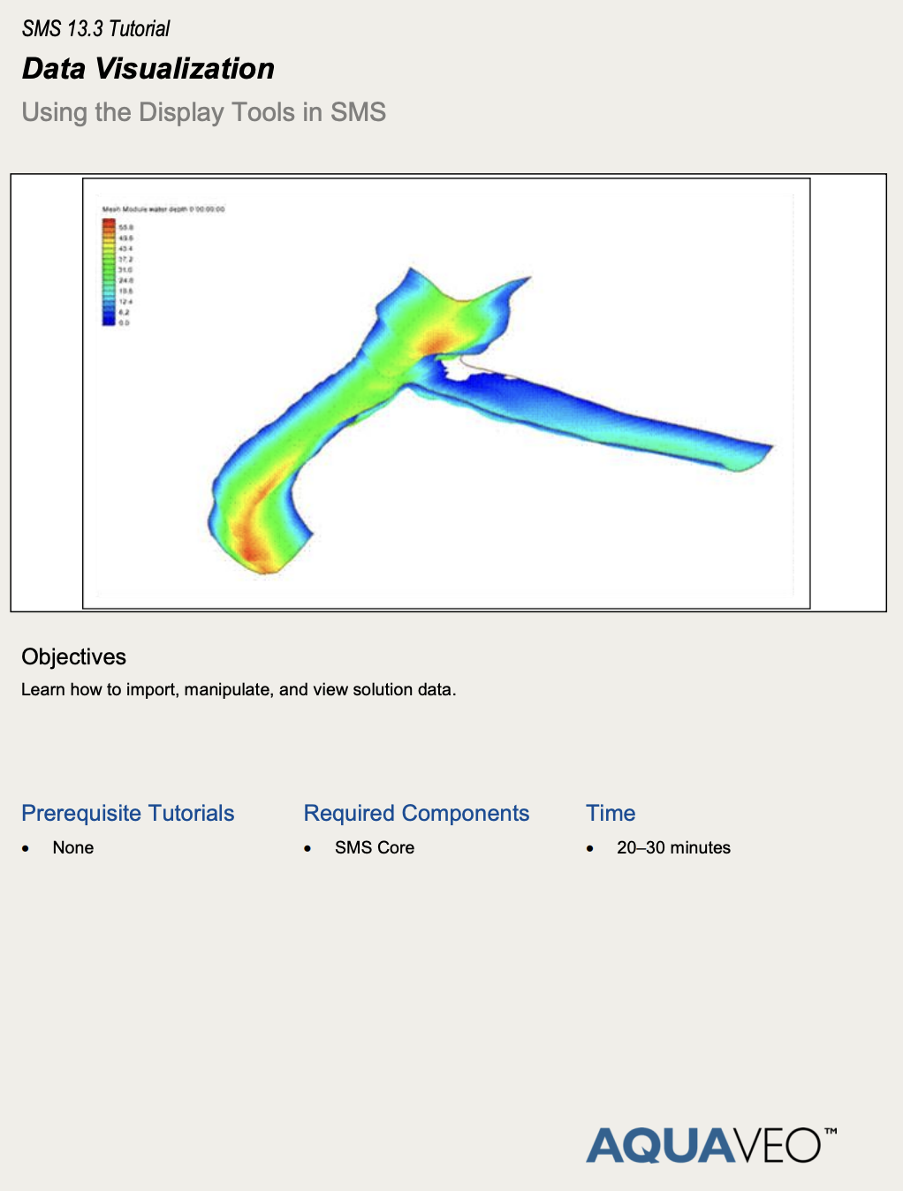
Demo

Slide 8
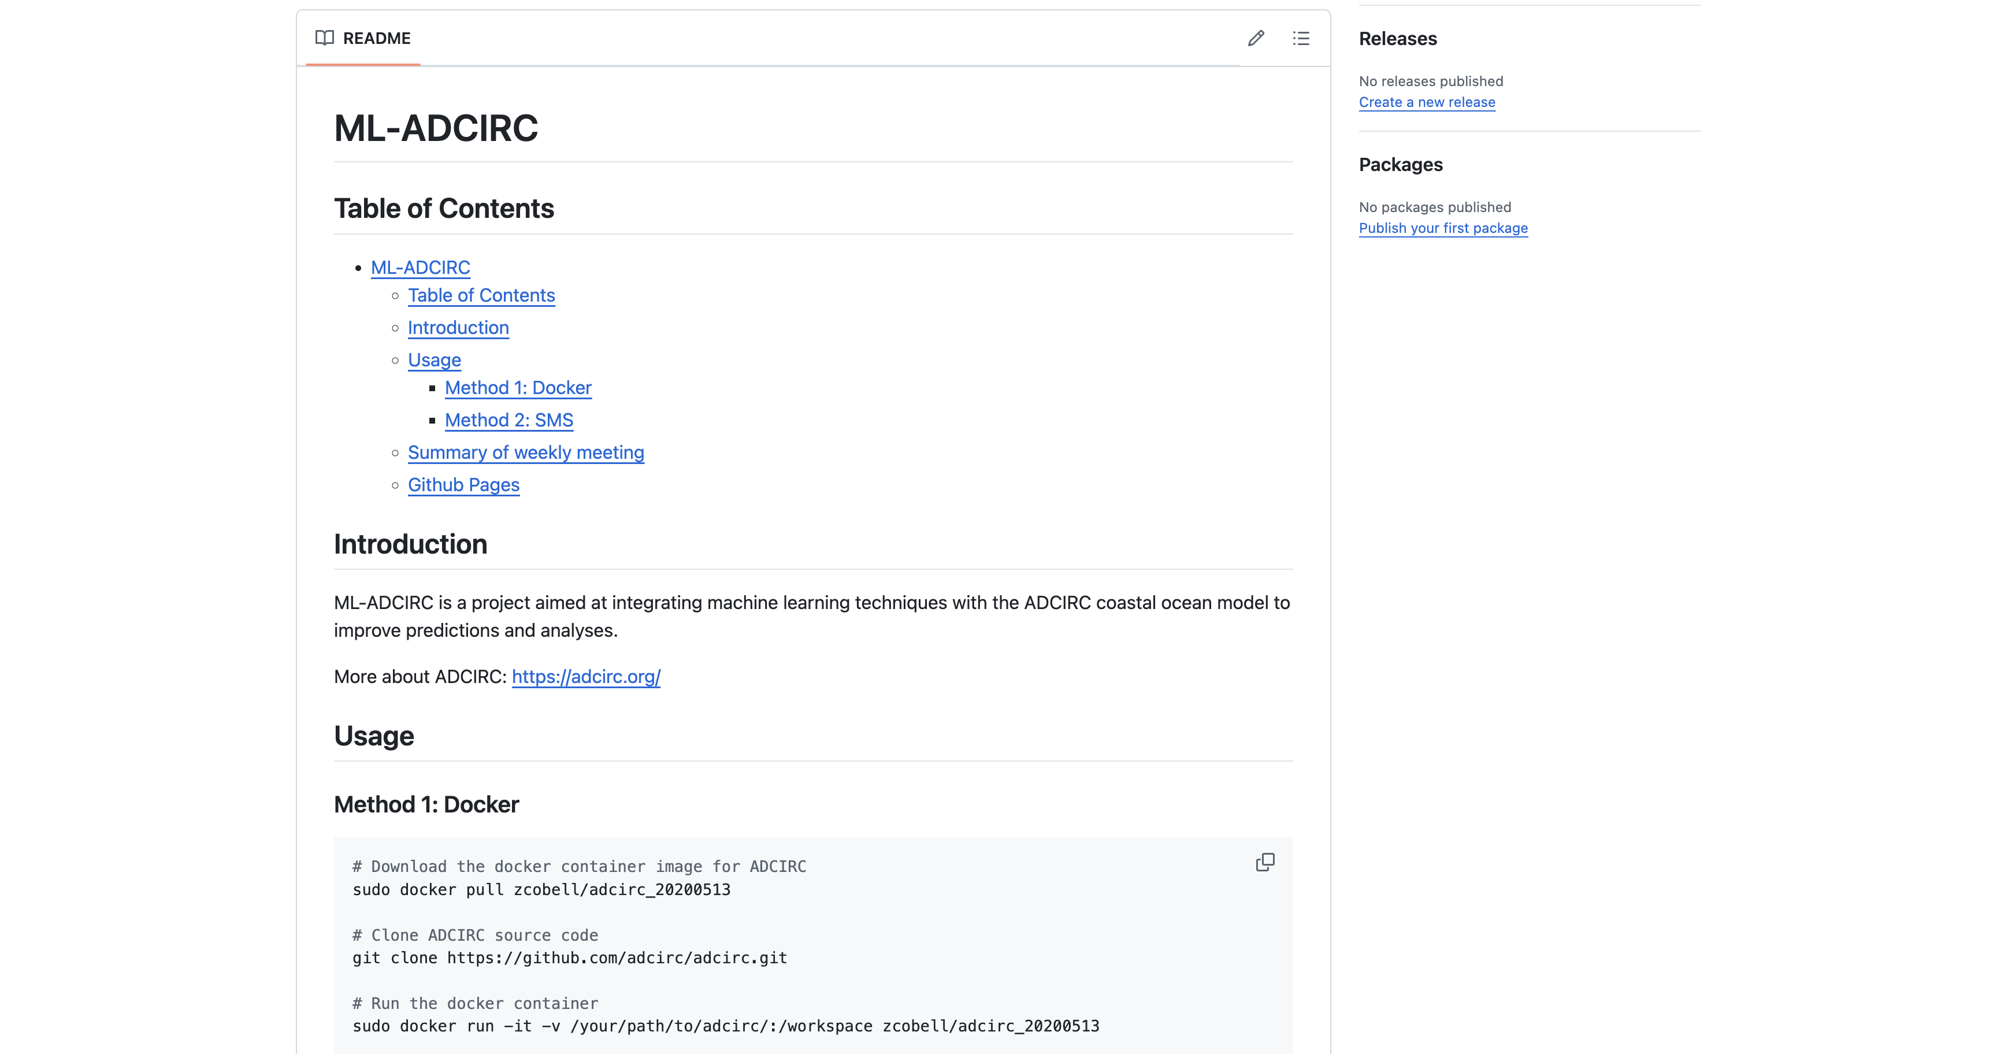
GitHub
https://github.com/yl1127/ML-ADCIRC

Slide 9
Reading suggestions from Ruyi
<<ADCIRC: An Advanced Three-Dimensional Circulation Model for Shelves, Coasts, and Estuaries>>
Report 1. Theory and Methodology (1992, Pages: 144)
Report 2. User's Manual (1994, Pages: 168)
<<Formulation and Numerical Implementation of the 2D/3D ADCIRC Finite Element Model Version 44.XX>> (2004, Pages: 75)
<<The Shallow Water Wave Equations: Formulation, Analysis and Application>> (1986, Pages: 188)

Slide 10
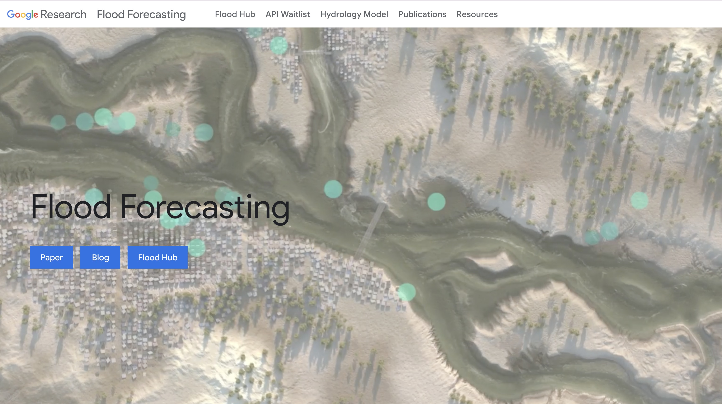
Flood Forecasting
https://sites.research.google/gr/floodforecasting/

Slide 11
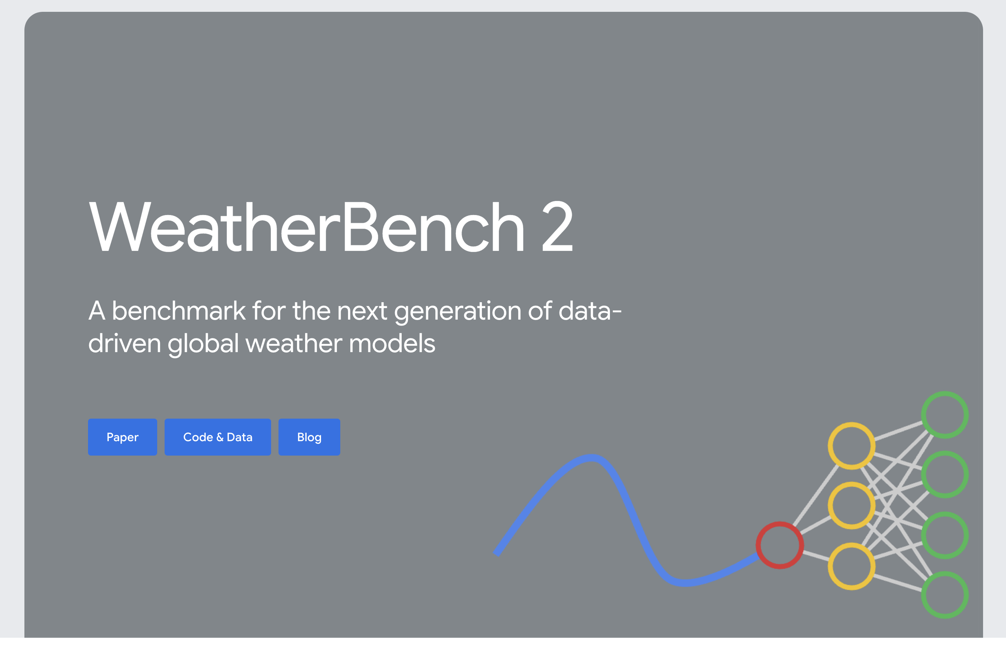
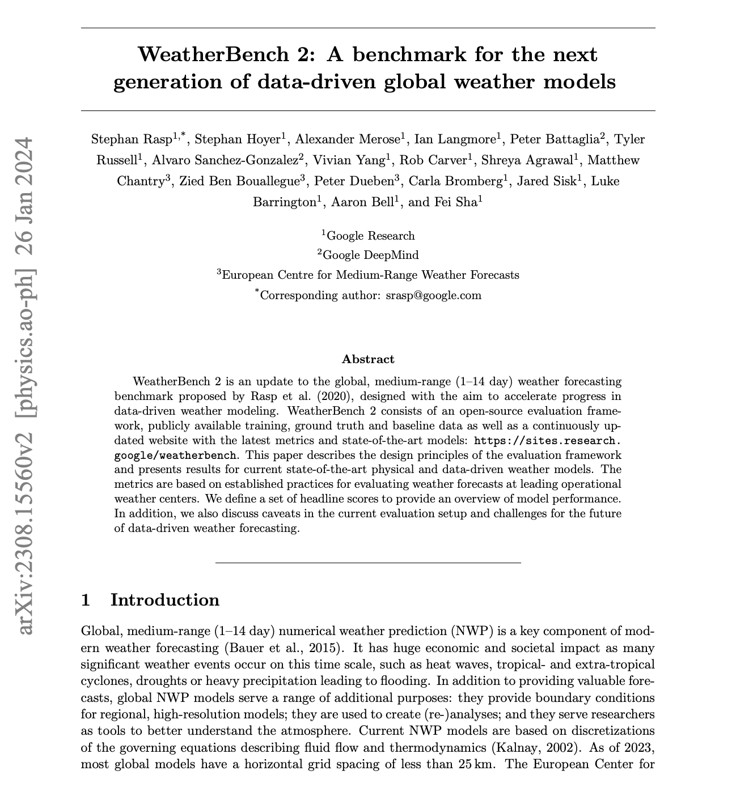
WeatherBench2
https://sites.research.google/weatherbench/
https://arxiv.org/pdf/2308.15560

Slide 12
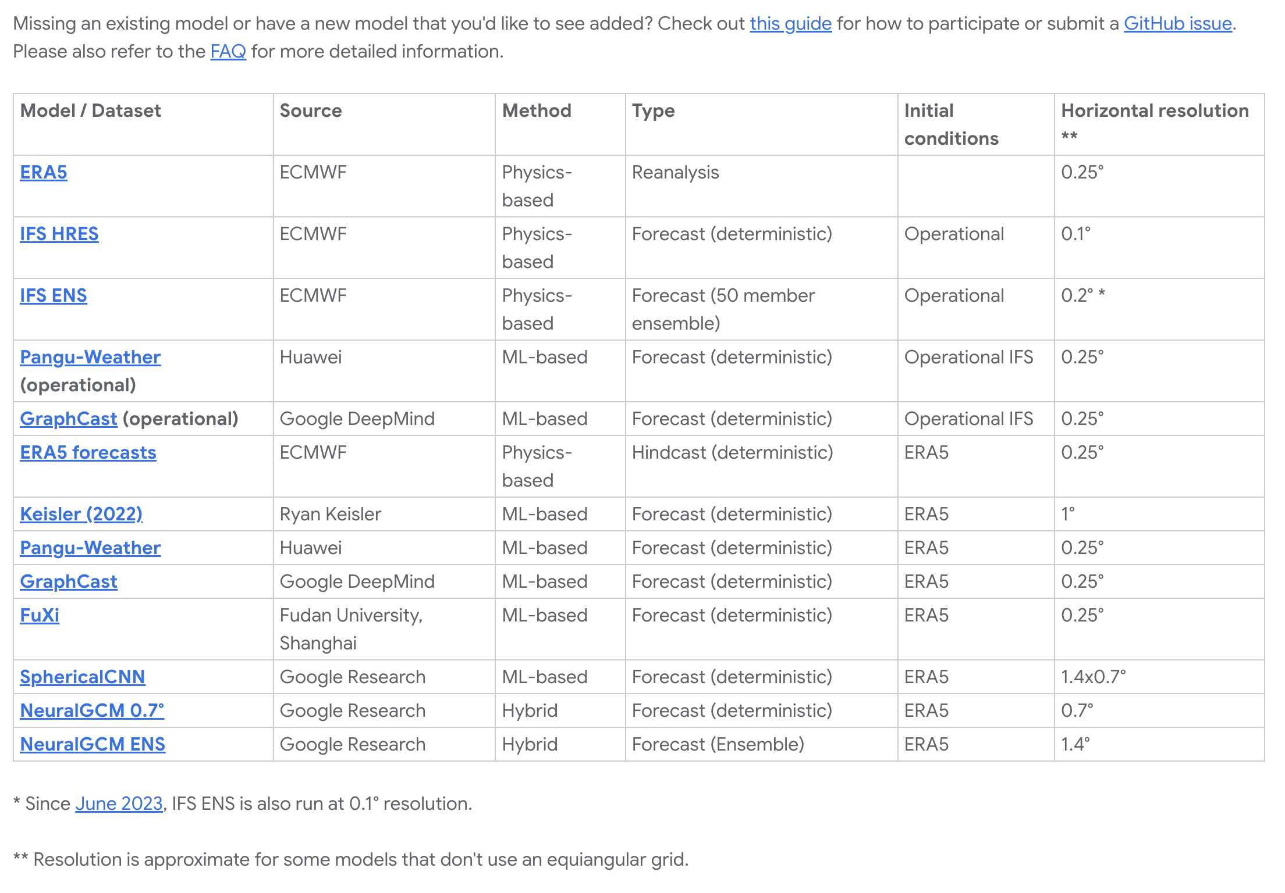
WeatherBench2: Participating models

Slide 13
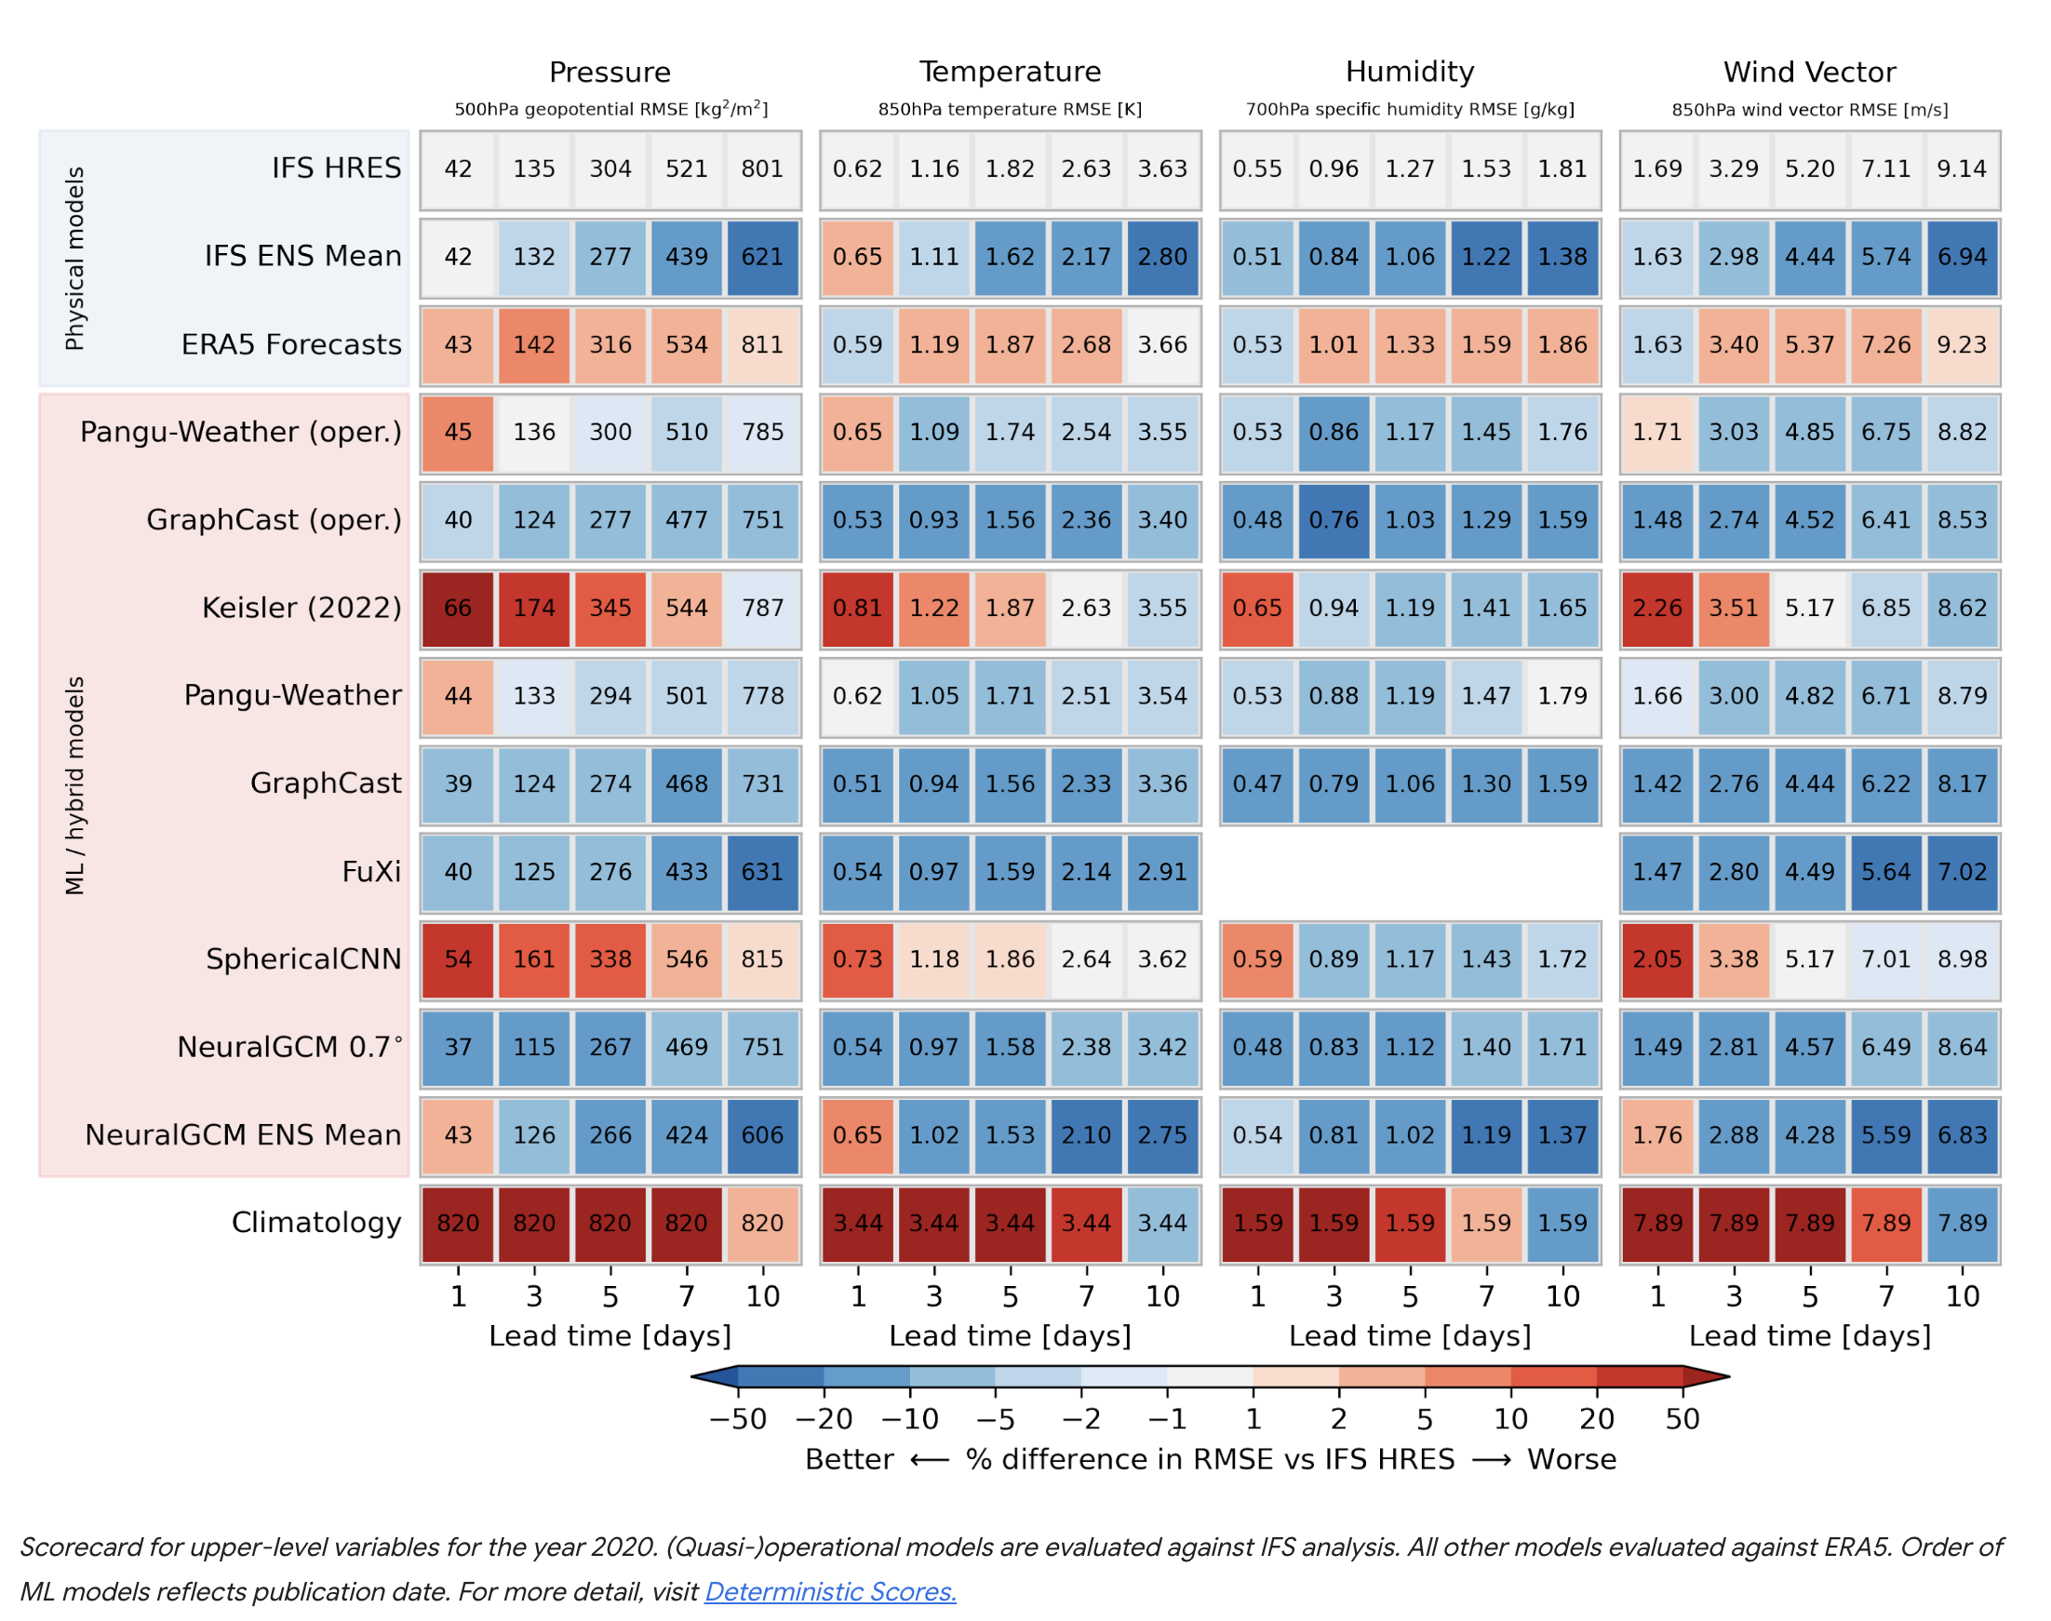
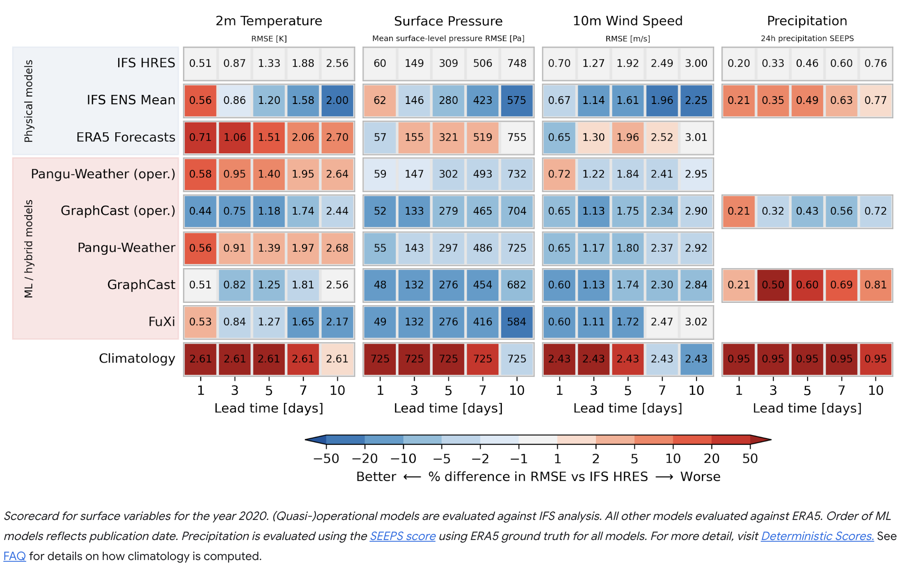
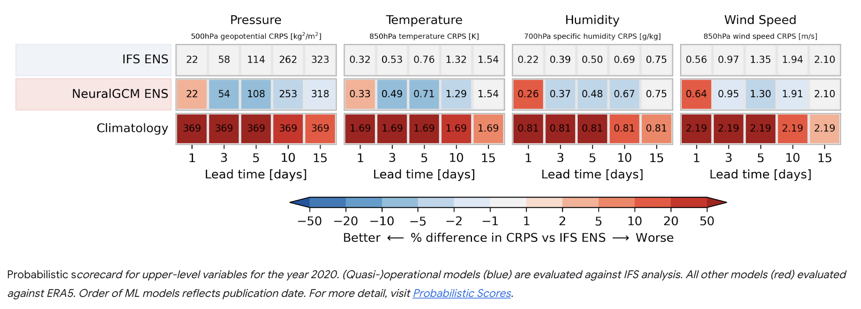
WeatherBench2: Headline scorecards

Slide 14
Discussion

